Slide 1

Research Question – Date: 20 -11 - 2024
Group Name: A97 Name of Student Presenting: Ram Manchem

Slide 2
DS074 Snippet Total Rows :93

Slide 3
This dataset is of interest to us because it allows us to analyse trends in food costs across countries over time. . Our Independent variable is: Year This Independent variable datatype is : Nominal. Our Dependent variable is: Food Cost. This Dependent variable datatype is : Continous.
Dataset ID: (DS074) (Food_Cost.csv)
Notes:
Before specifying your Research Question you must define the type of data you are analysing. Are the variables you select interval data (measurement data you can divide, multiple, etc), OR are they ordinal (there is a definite order but the intervals between each variable are not necessarily equal, or the terms might be subjective like in a likert scale); OR are they just categorical/nominal (Items such as film names, cities, etc., that you can count numbers of occurrences? You also need to understand whether the variable is either dependent or independent and this will vary according to the context. Independent variables may cause an effect, whereas the dependent variable might be effected by the independent variable. Check the lecture notes on the RQ for more information and examples.
You will get only one opportunity to present your Research Question ahead of the submission date. Have your questions ready, and be ready to take notes on feedback.

Slide 4
Is there a difference in the mean of food costs of all countries between the year 2013 and 2014?
Our Research Question is

Slide 5
PRE 7COM1079-2024 Student Group No: A97
Hypothesis
Null hypothesis (H₀): There is no difference in the mean of food costs of all countries between the year 2013 and 2014.
.
2. Alternative hypothesis (H₁): There is a difference in the mean of food costs of all countries between the year 2013 and 2014..

Slide 6
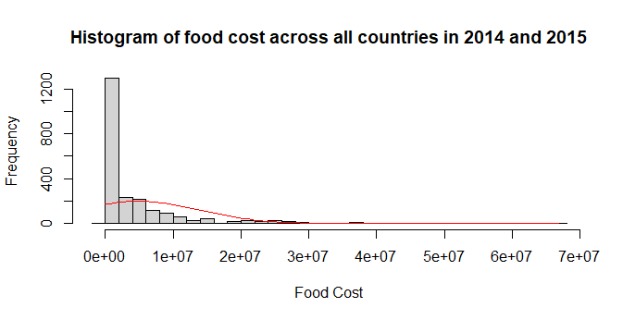
Visualization :Histogram
The histogram confirms that food costs are heavily right-skewed, with most values clustered at lower costs and a few extreme values at the higher end.

Slide 7
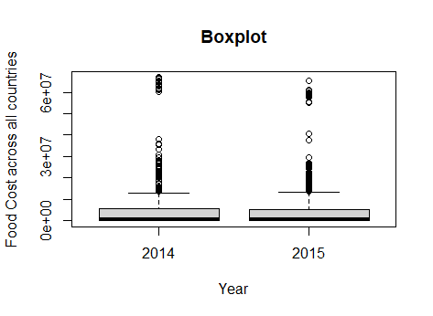
Visualization: Boxplot
The boxplot shows that the distribution of food costs for 2014 and 2015 is highly skewed with outliers, but the median and spread (IQR) appear similar for both years.

Slide 8
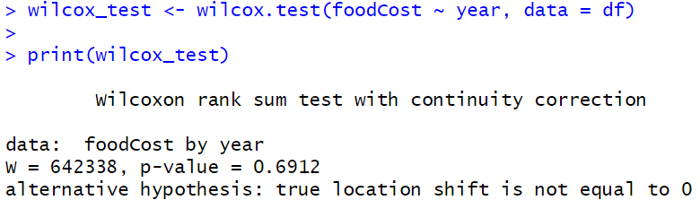
Test Conclusion:
From the histogram, we observed that the data is not normally distributed. Therefore, Based on the Wilcoxon rank-sum test, there is no significant difference in the food costs between the years 2013 and 2014 for all countries (p-value = 0.6912).

